Slide 1
Final Presentation
By Caleb Latimer & Daniel Warrick

Slide 2
Introduction
Caleb Latimer
Dev/ other
Seeking to learn QT and openGL
Build project, run tests and build documentation
Role: Developer
Build menu
Taking CSC 3110, 3100/3101
Seeking to learn Qt and OpenGL
Dan Warrick
Dev
Build project, add features, fix bugs
Enhance Skill-set with working knowledge of 3D imaging
Role: Developer
Design Strategy
Taking CSC 3100, 4100 and 5430
Trying to enhance my skillset with a working knowledge of 3D imaging

Slide 3
Approach
Big Picture
Design Strategy
Project Schedule
Final Result Explanation
Demo
Limitations and Drawbacks
Questions

Slide 4
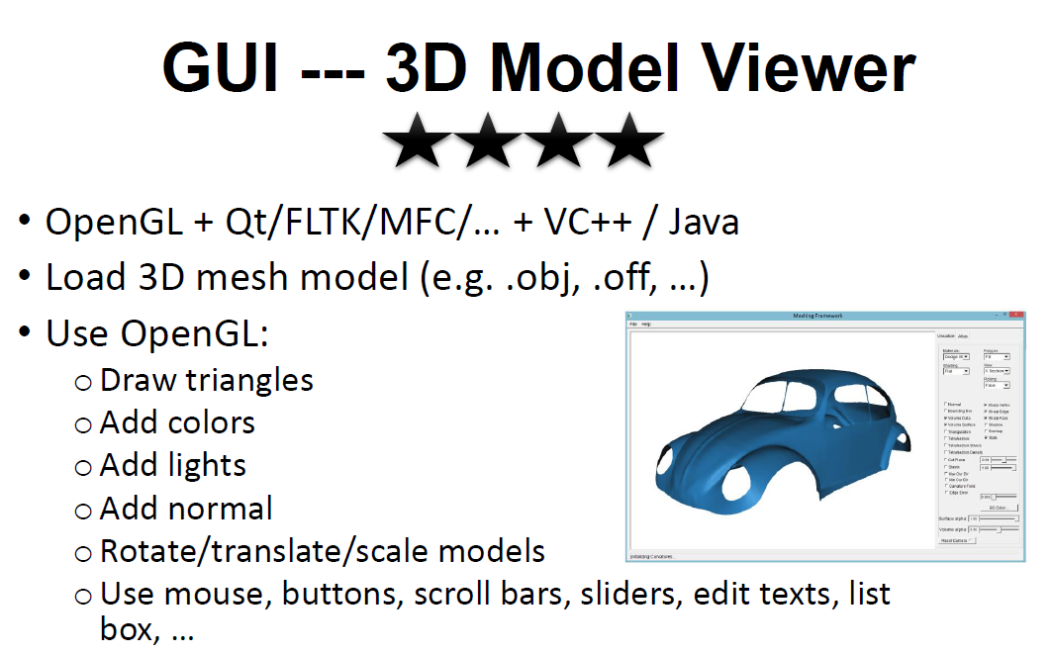
Big Picture

Slide 5
Big Picture Cont.
Goals were to load a mesh model from a drop-down menu
Display model in center pane
2 horizontally oriented menus on either side
Buttons to add lights, spotlight position and and angle set by text box in right submenu shadows will adjust according to the light position
Add colors preset color icons to be positioned on the left submenu , the selected color variable will affect the drawing and paint functions

Slide 6
Big-picture cont.
Rotate translate using coordinates in text-boxes and in the right submenu to determine initial values
Arrow keys to translate the image while dragging the mouse and rotates
Zoom implement several zoom presets
Draw additional shapes onto the model

Slide 7
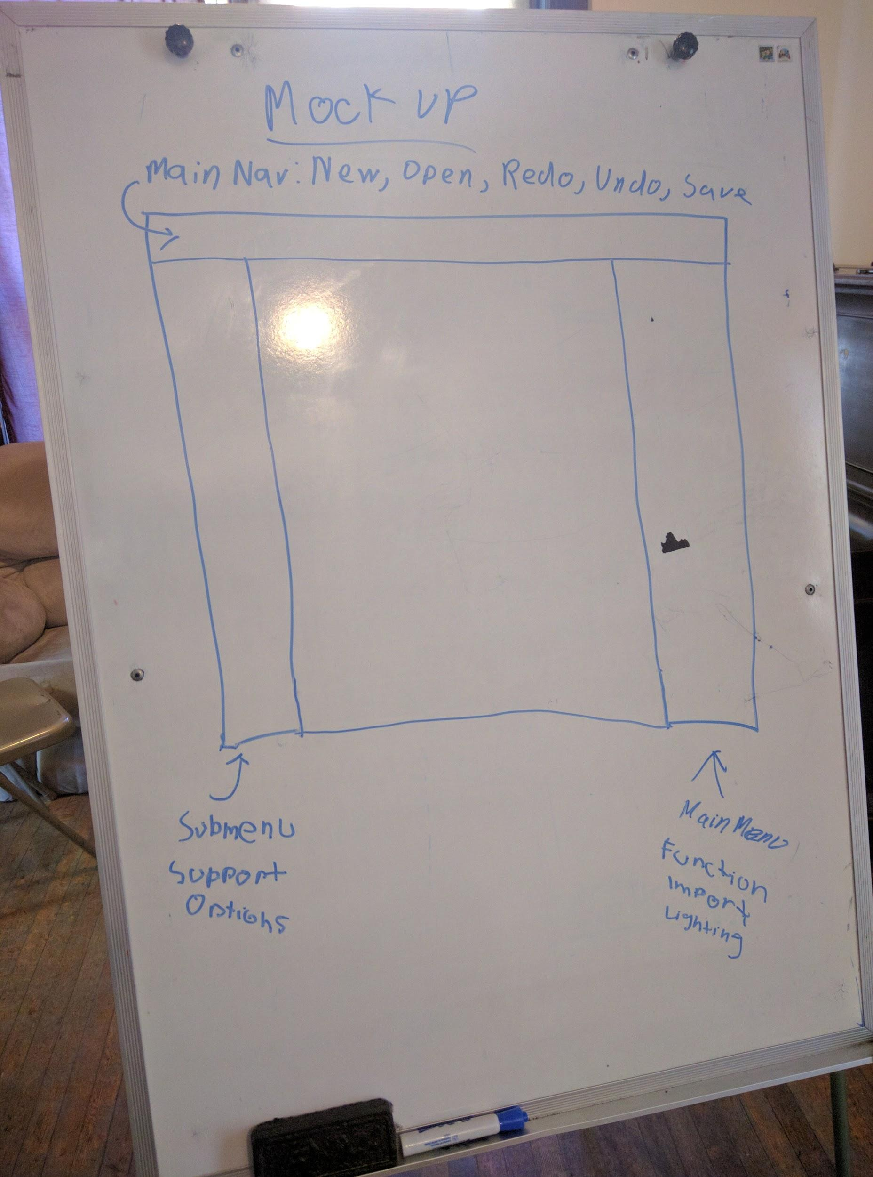
Mock-up whiteboard

Slide 8
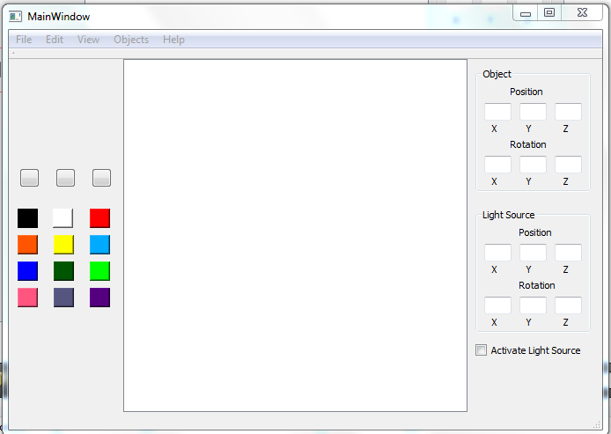
Mock up sketch

Slide 9
HCI Design Strategy
Menu driven application
Drop-down menu
Toolbar menu
Keyboard shortcuts
The use of icons
Direct manipulation through pointing device

Slide 10
HCI Design Cont.
-Freeglut/Glew/OpenGL
-Create Window
-Read .obj data into vectors (1 for vertices, 1 for faces)
-Create rendering context
-Pipelining
-Apply keylisteners for transformations

Slide 11
Project Schedule
11/01 present mock-up
11/10 have functional menu layout
11/20 have fully working first round
12/5 fully debug and test
12/8 present final version

Slide 12
Project Schedule Cont.
Changes had to be made
Bugs cannot be scheduled

Slide 13
Planned Final Expectations
Meets requirements
works as designed
Gain knowledge of QT + OpenGL
Be able to build off of it into a more complex version later

Slide 14
Final Results
Wasn’t able to implement everything that was previously desired
-Menu, toolbar, fragment shaders, lighting

Slide 15
Final Results Cont.
Functionality accomplished:
-Application can read any .obj file of the same format as the file provided
-Vertex Shaders/Color, works with all standard primitives
-Simulated transformations via keylisteners which alter camera position

Slide 16
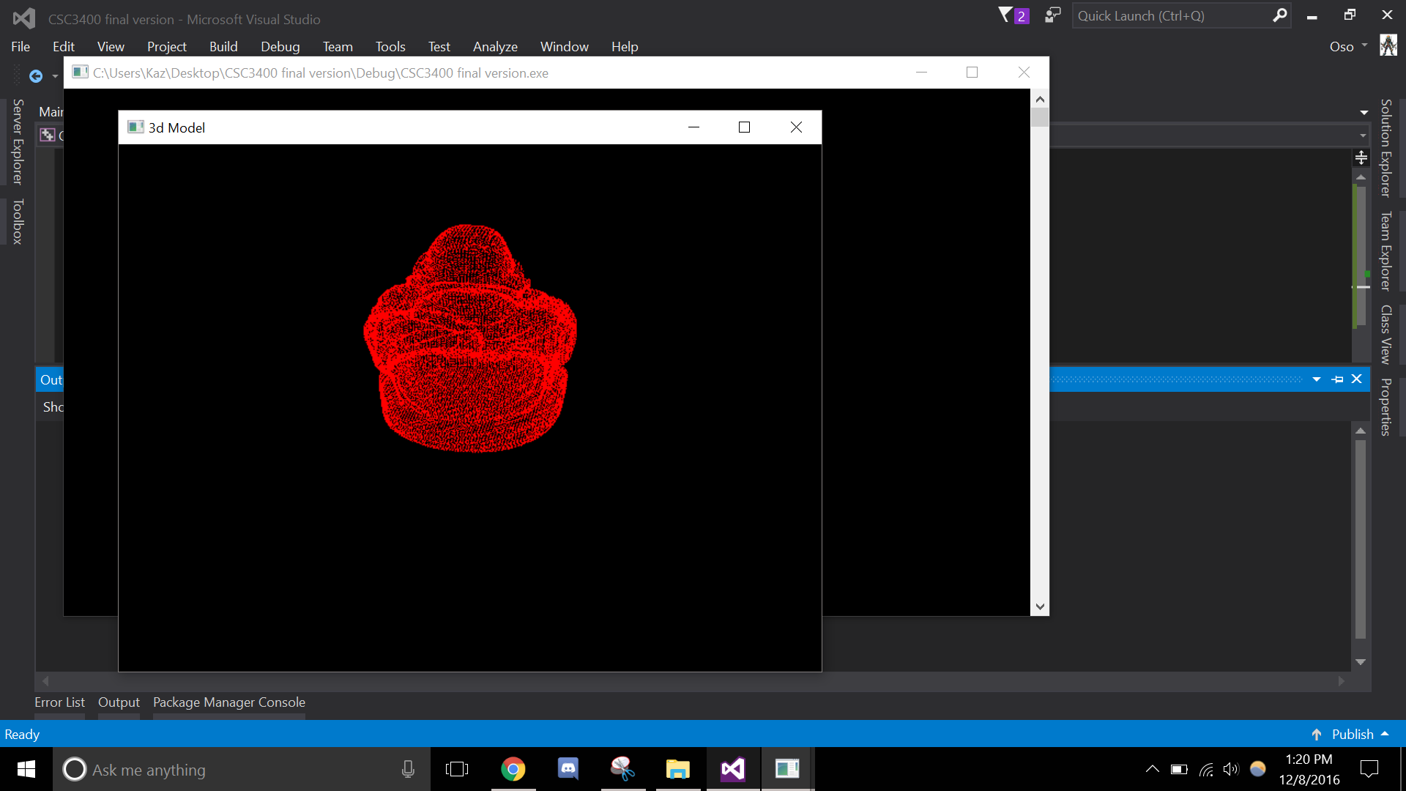
Screenshot of result

Slide 17
Demo
Please wait…
With Glut

Slide 18
Limitations and Drawbacks
Attempted approaches:
-Visual Studio with QT/OpenGL: QGLWidget issues; no GL context
-QT Creator: Fatal error; more QGLWidget issues
-Pursuing the previous approaches in a different OS (virtualBox)
Limitation:
-Minimal GUI support included in Glut library

Slide 19
Limits and Drawbacks Cont.
-difficulties associating fragment shaders (faces) with vertices
-glm solution

Slide 20
Questions/Comments

Slide 21
THANK YOU!

